Slide 1
PUBG player ranking prediction
Team 8: Yimu Liu, Ziyang Wei
Notes:
PUBG player ranking prediction: create a model which predicts players' finishing placement based on their final stats, on a scale from 1 (first place) to 0 (last place).

Slide 2
Introduction
A battle royale game with nearly one hundred players.
Since 2017, it has become popular all over the world.

Slide 3
Data source https://www.kaggle.com/c/pubg-finish-placement-prediction
Dataset contains 59 columns and over 4000000 rows
Data fields(Example)：
DBNOs - Number of enemy players knocked.
assists - Number of enemy players this player damaged that were killed by teammates.
boosts - Number of boost items used.
damageDealt - Total damage dealt. Note: Self inflicted damage is subtracted.

Slide 4
Milestone
Prepare the Dataset
Data Preprocessing
Drop abnormal data
Data Analysis
Calculate the correlation of all columns
Select 22 columns as features
Predict Pubg Player Ranking
Train the model and find the best model
Predict the result
Analyze Prediction

Slide 5
Program in scala
Data preprocessing
Calculate the correlation
lm model
All the unit test
GitHub:https://github.com/ziyang222/7200teamwork-pubg-ranking-prediction.git

Slide 6
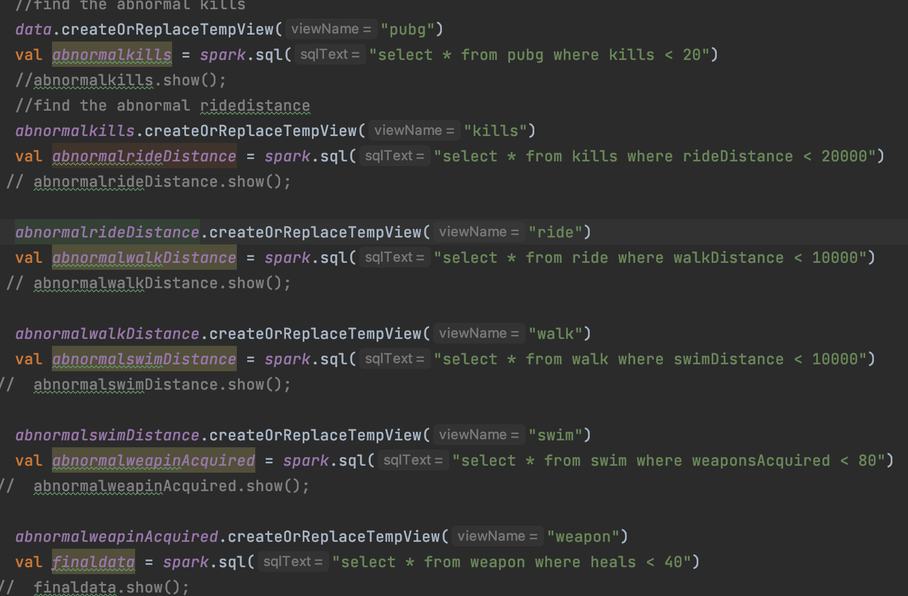
Data preprocess
Try to find abnormal data (eg, too many kills, too much healing, too long travel distance)

Slide 7
Data Preprocess
Training dataset : Validation dataset = 0.8 : 0.2
Test dataset : dataset = 0.1 : 1
Standardize all data

Slide 8
Data Analysis
Calculate the correlation of all columns
Select 22 columns as features
Consolidate highly relevant data
Remove data that have small correlation with result

Slide 9
Acceptance criteria
The RMSE represents the square root of the second sample moment of the differences between predicted values and observed values.
the coefficient of determination, denoted R² or r² and pronounced "R squared", is the proportion of the variance in the dependent variable that is predictable from the independent variable(s).
RMSE<0.15 r² >0.5 r²~1

Slide 10
Acceptance criteria
Model | RMSE | r²
RandomForest | 0.0397 | 0.9832
DecisionTreeRegression | 0.0089 | 0.9991
GradientboostedTreeRegression | 0.0082 | 0.9992
Time for Loading Best Model:
Approximately 30 seconds
LinearRegression | 0.2507 | 0.3317
RMSE<0.15 r² >0.5 r²~1
Notes:
MSE<0.02 RMSE<0.15 MAE<0.1 SMAPE<80%

Slide 11
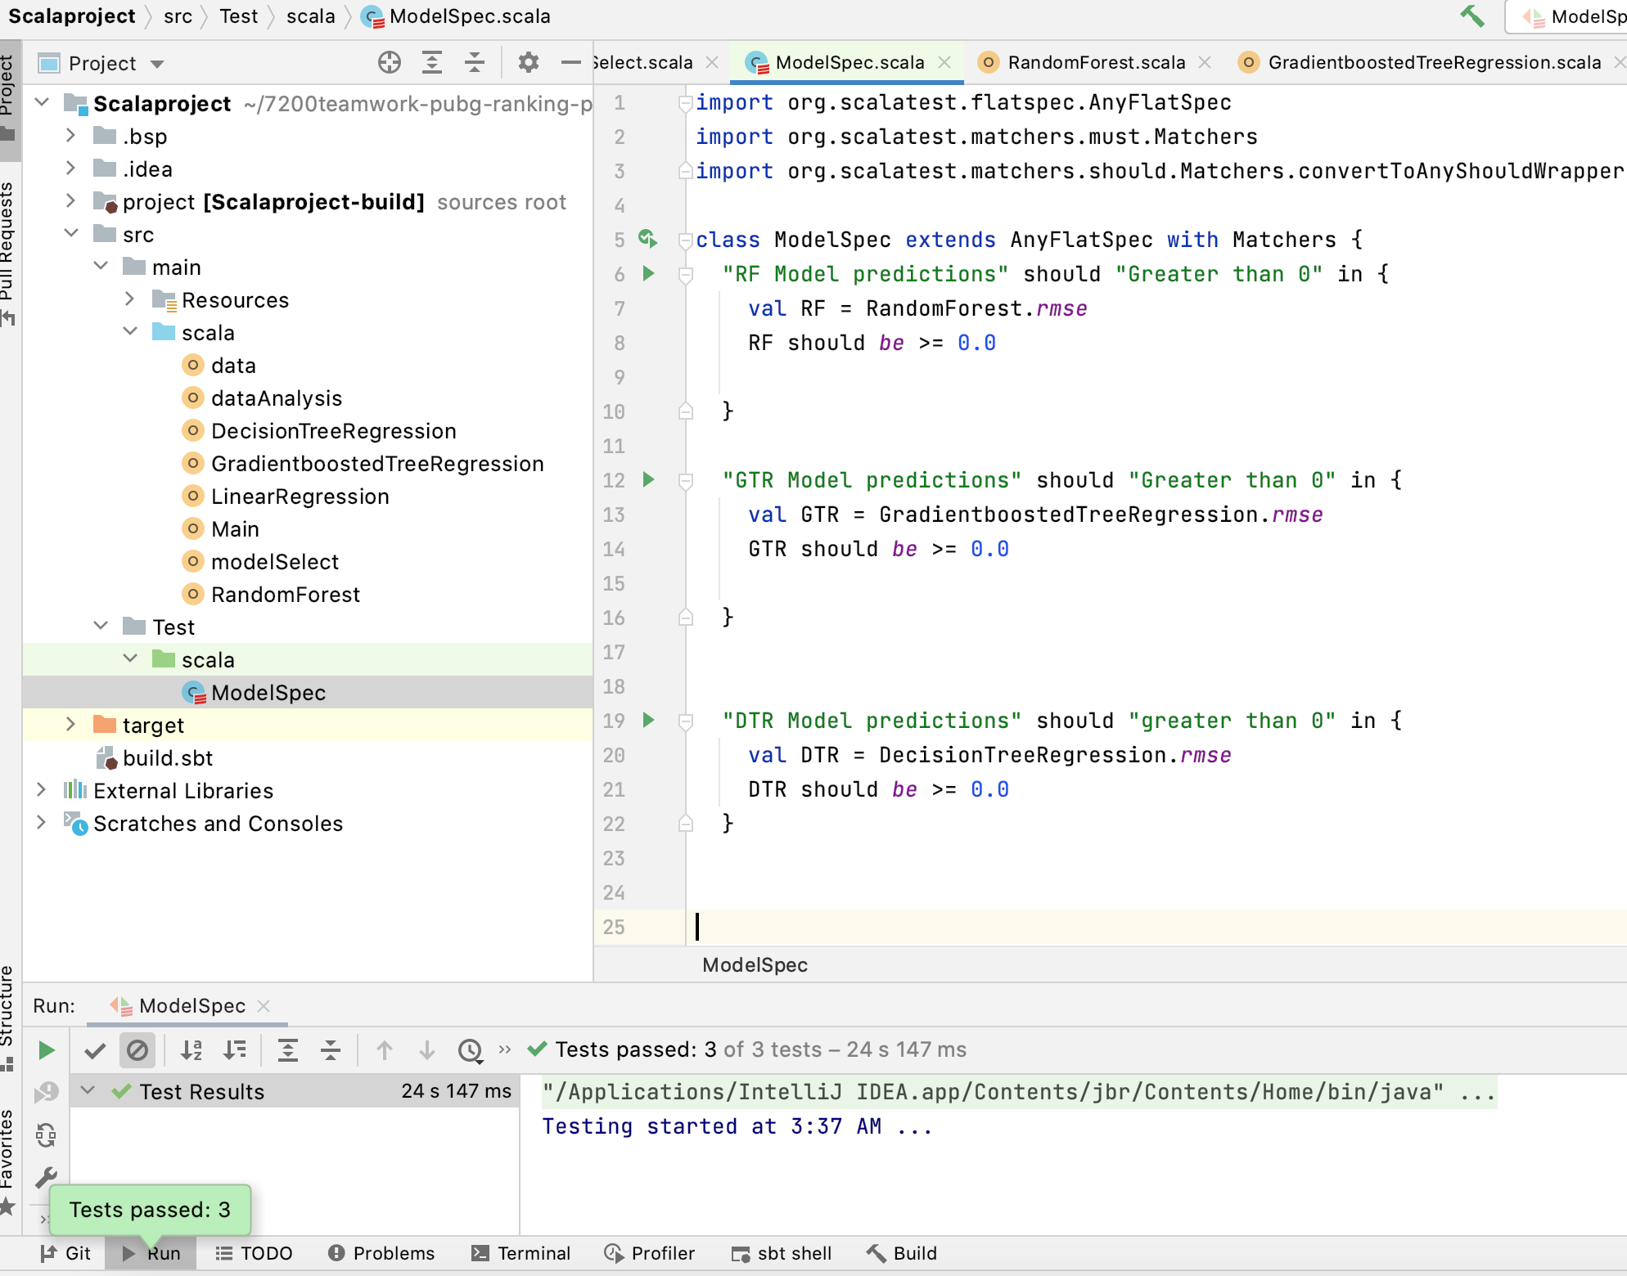
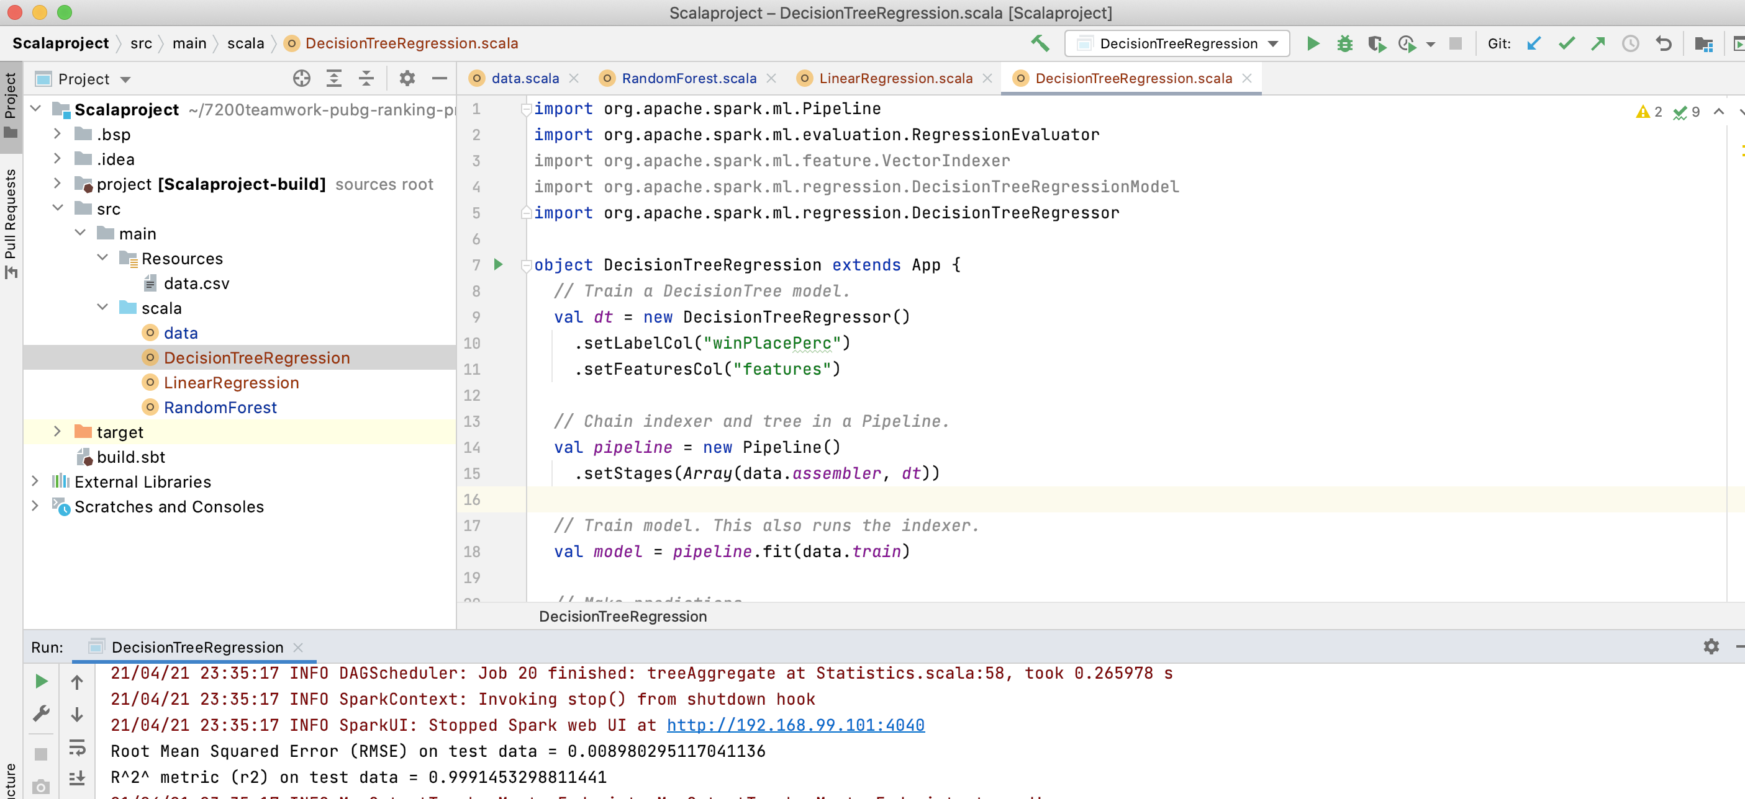
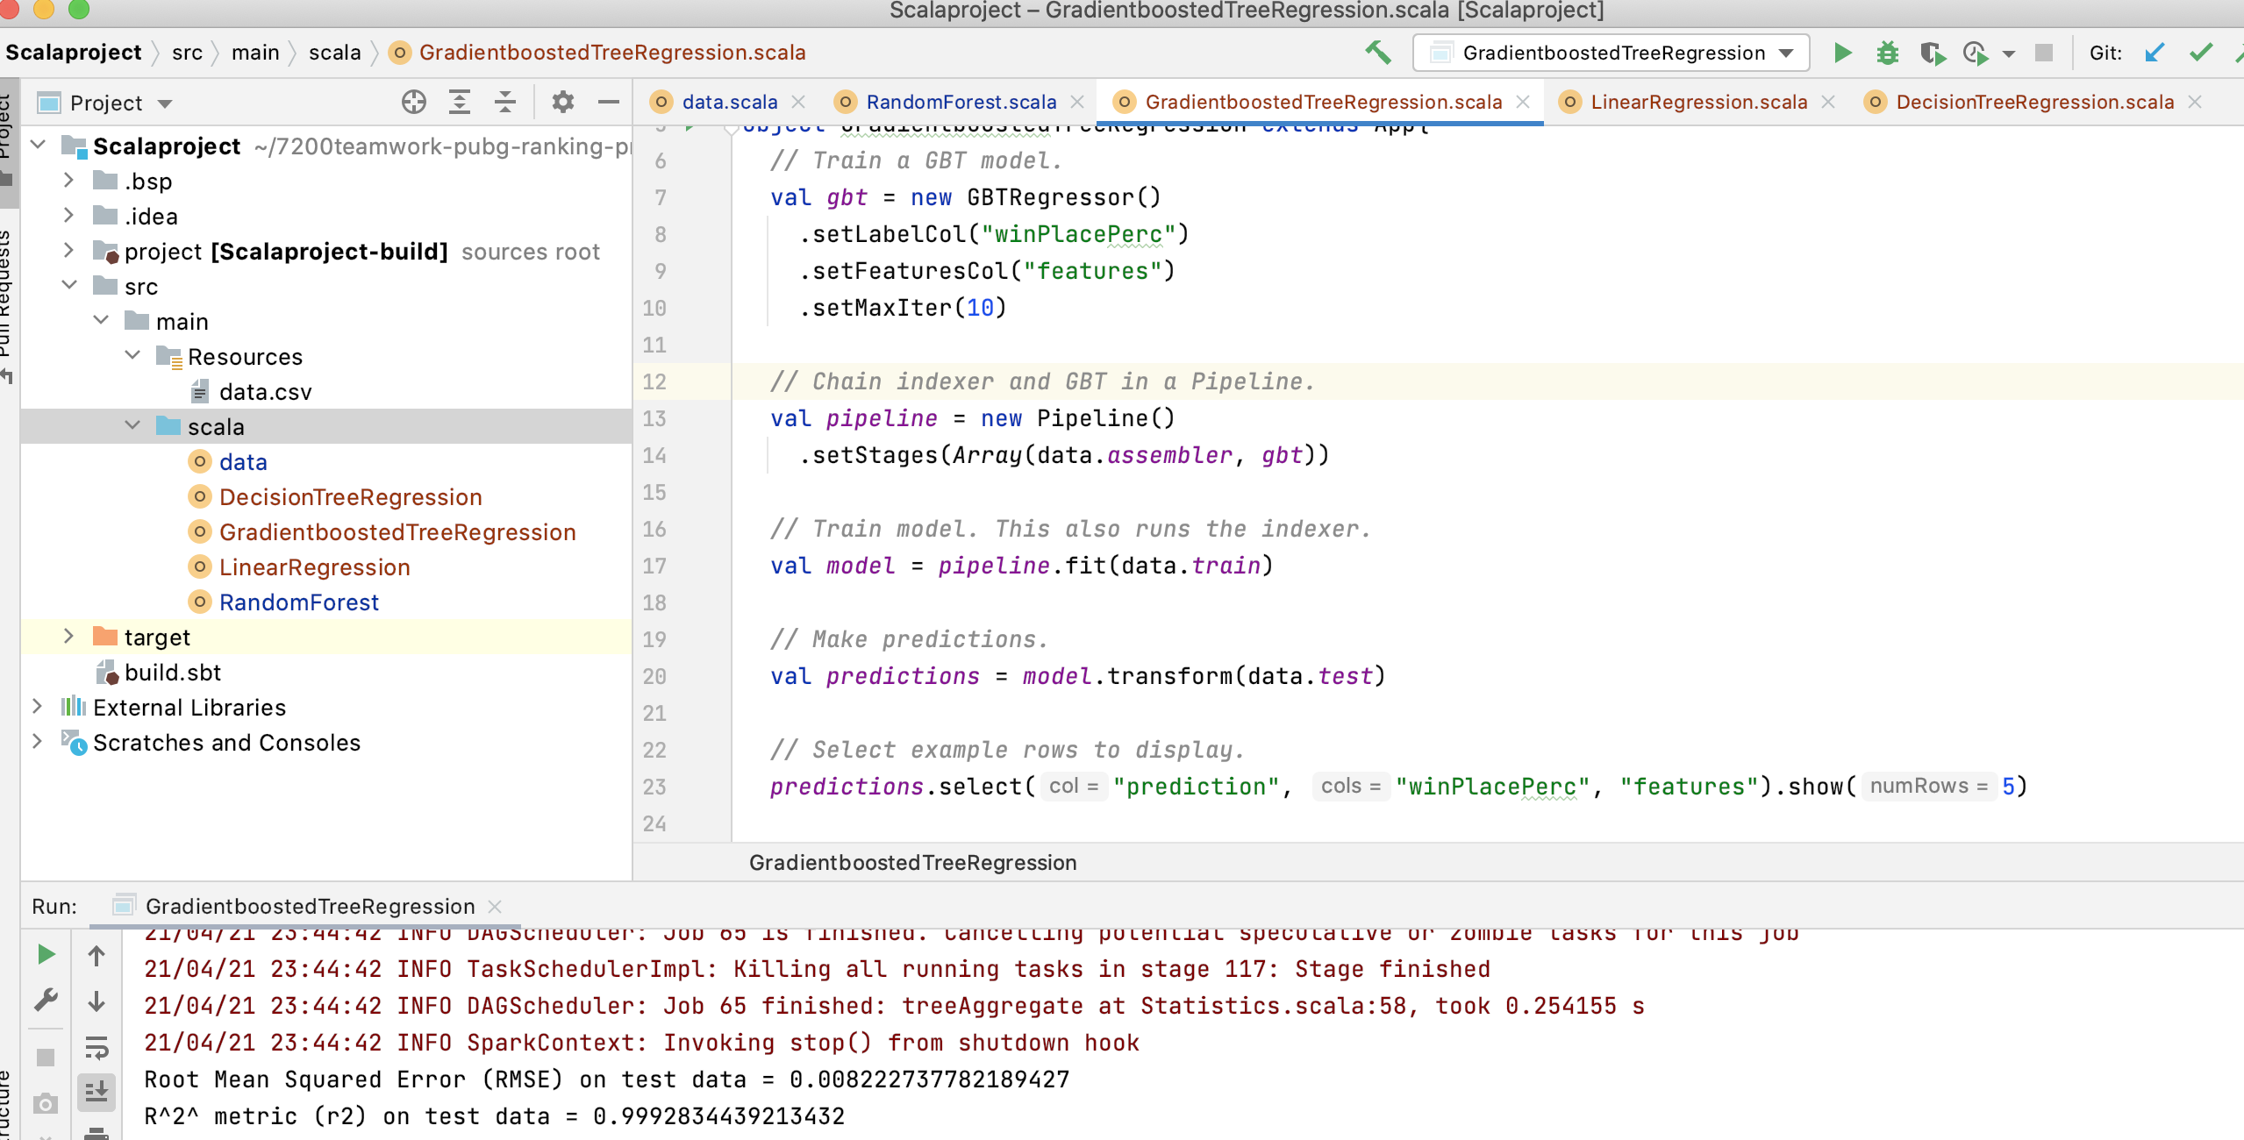
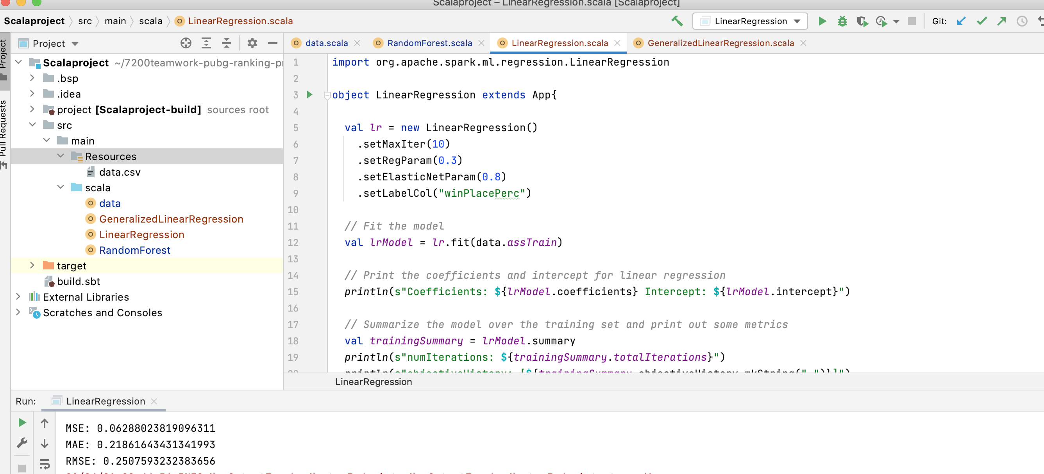
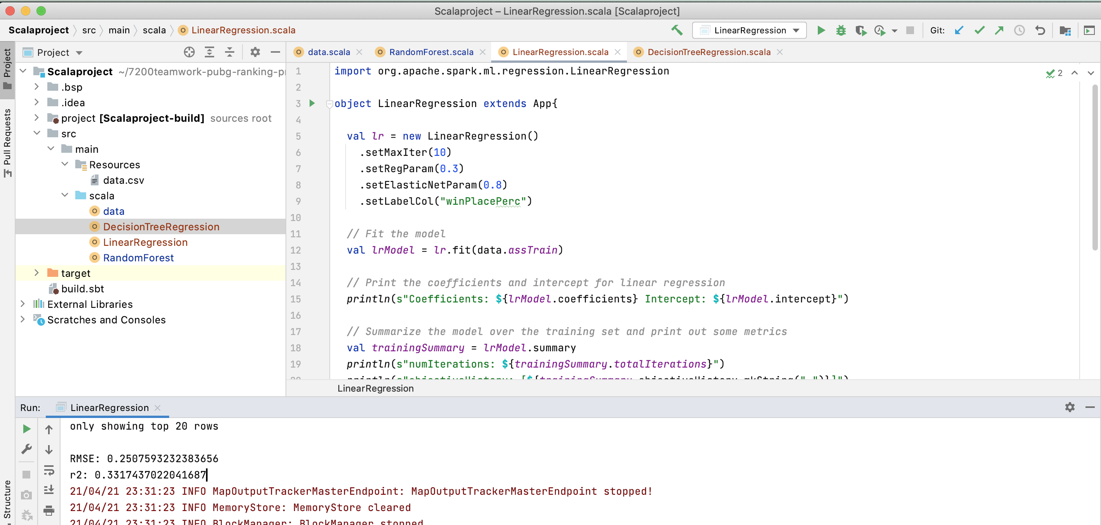
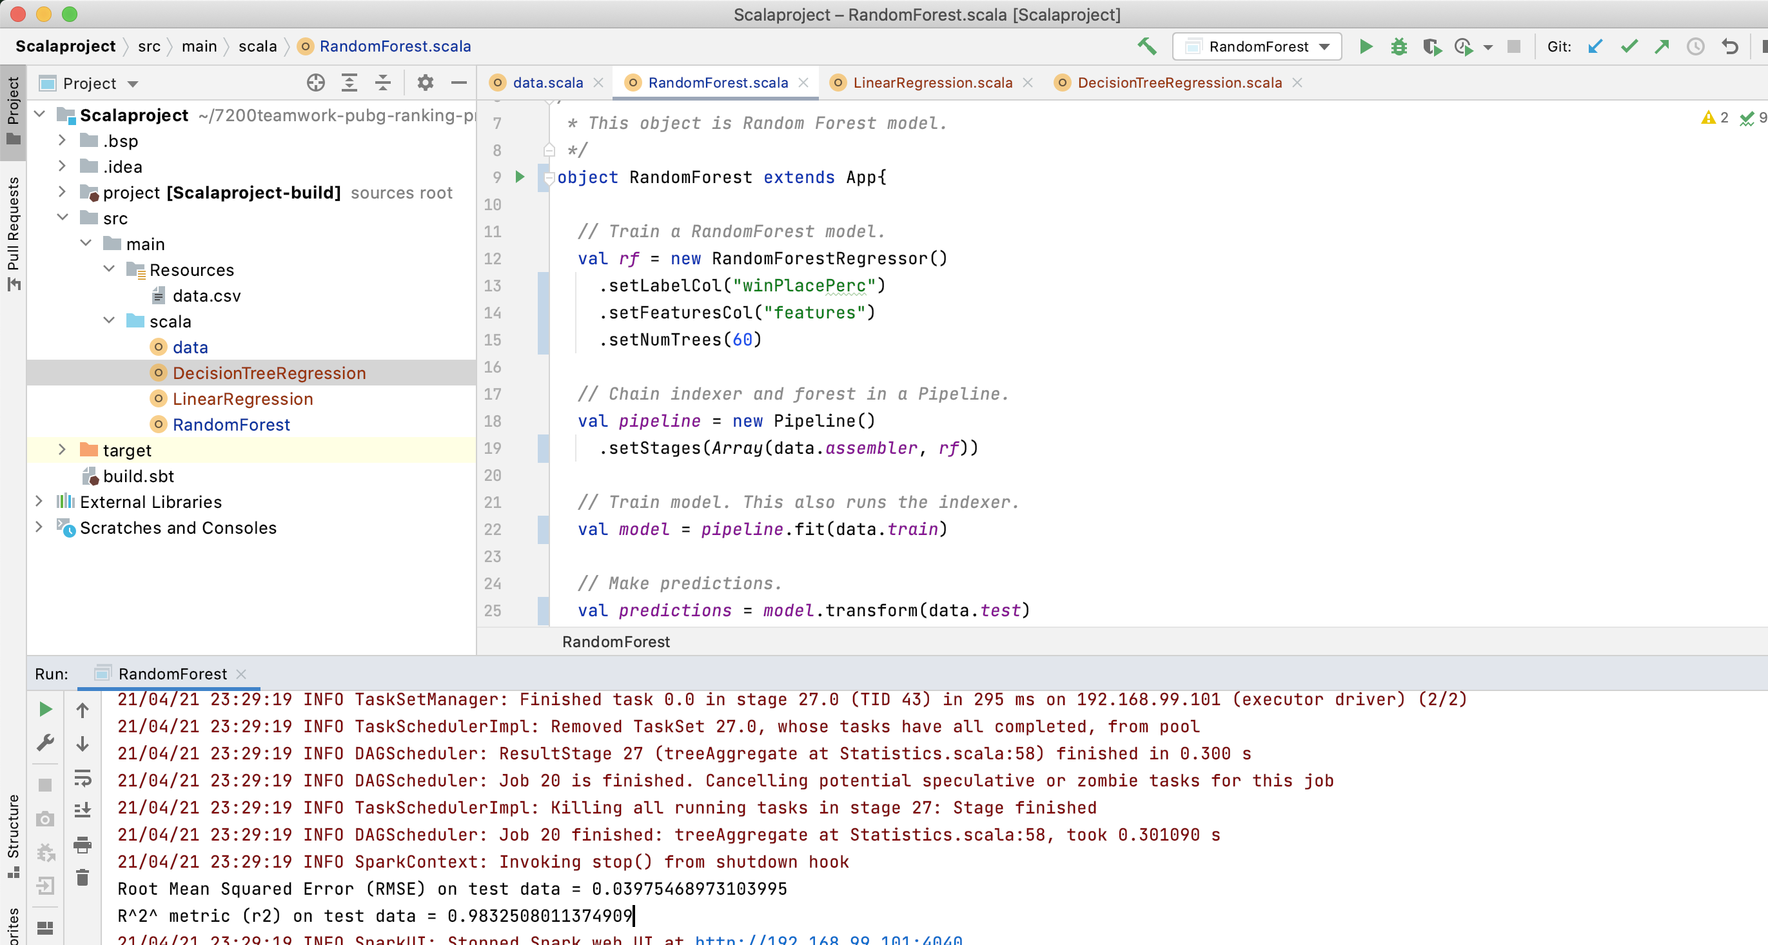
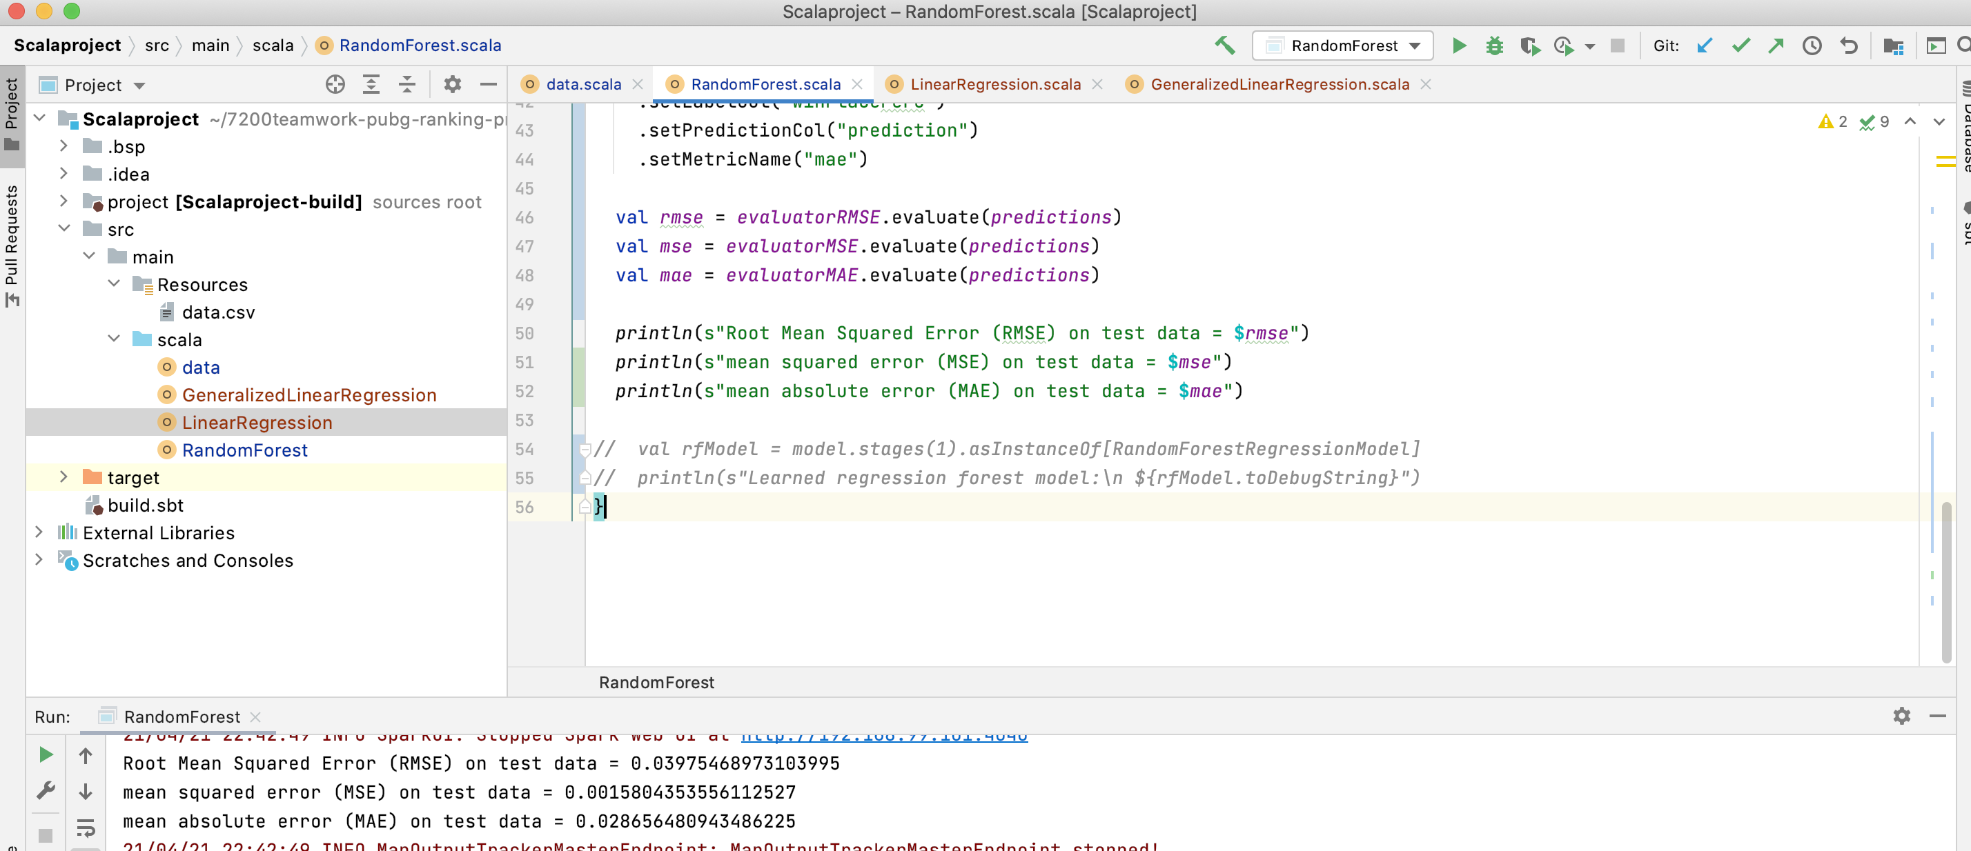
Test Cases

Slide 12
Use Cases
According to the records to train different models
According to the input, predict the ranking of the players
System predicts based on the best model we choose

Slide 13
Goals of Project
Design a predicting system based on the match histories’ records
Process prediction by performing different models
For us, we learn more about specific algorithm and the using of scala.

Slide 14
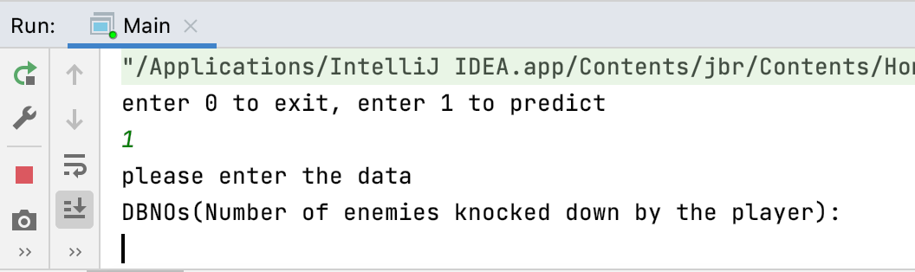
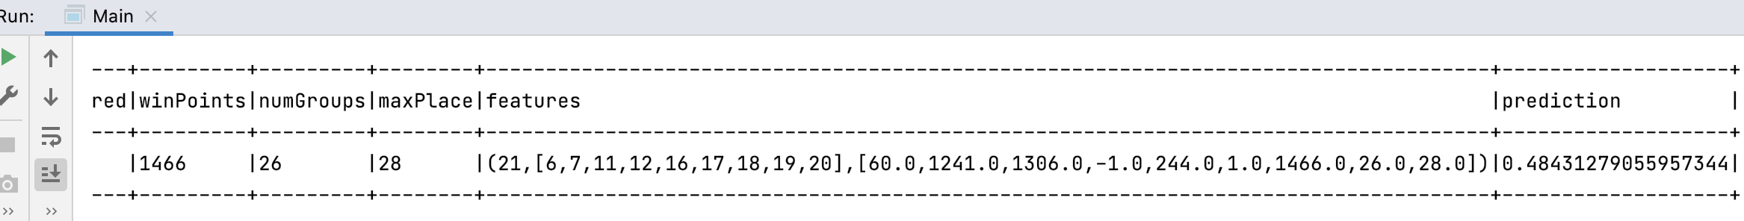
UI demo
Input
Output

Slide 15
Thanks for your watching!

